Slide 1

Zomoto Restaurent
Exploratory Data Analysis

Slide 2
Introduction
Zomato is an online food delivery and restaurant discovery platform
It handles huge amounts of data daily
Python is widely used to analyze, automate, and optimize Zomato’s operations

Slide 3
Why Python for Zomato?
Easy to learn and use
Powerful data analysis libraries
Fast processing of large datasets
Used in real-time decision making

Slide 4
Distribution of Restaurant Ratings
Most restaurants have ratings between 3.5 and 4.5, showing generally good customer satisfaction
Very few restaurants receive low ratings (below 2.5)
High ratings (above 4.5) are less common, indicating strict customer expectations
The distribution suggests that food quality, service, and delivery time strongly influence ratings

Slide 5
Cost Analysis
Restaurants with moderate pricing tend to receive higher customer ratings
Very low-cost restaurants often face quality concerns, affecting ratings
High-cost restaurants do not always guarantee higher ratings
Overall, value for money has a strong impact on customer satisfaction

Slide 6
Top 10 Cusions
The top 10 cuisines account for the majority of customer orders on Zomato
Indian, Chinese, and Fast Food are the most popular cuisines
High demand reflects affordability, taste preference, and quick preparation time
These cuisines drive higher restaurant visibility and revenue

Slide 7
Sentiment Analysis
Most customer reviews show positive sentiment, indicating overall satisfaction
Neutral reviews reflect average service or food quality
Negative sentiment is mainly linked to delivery delays and poor service
Sentiment analysis helps restaurants identify issues and improve customer experience

Slide 8
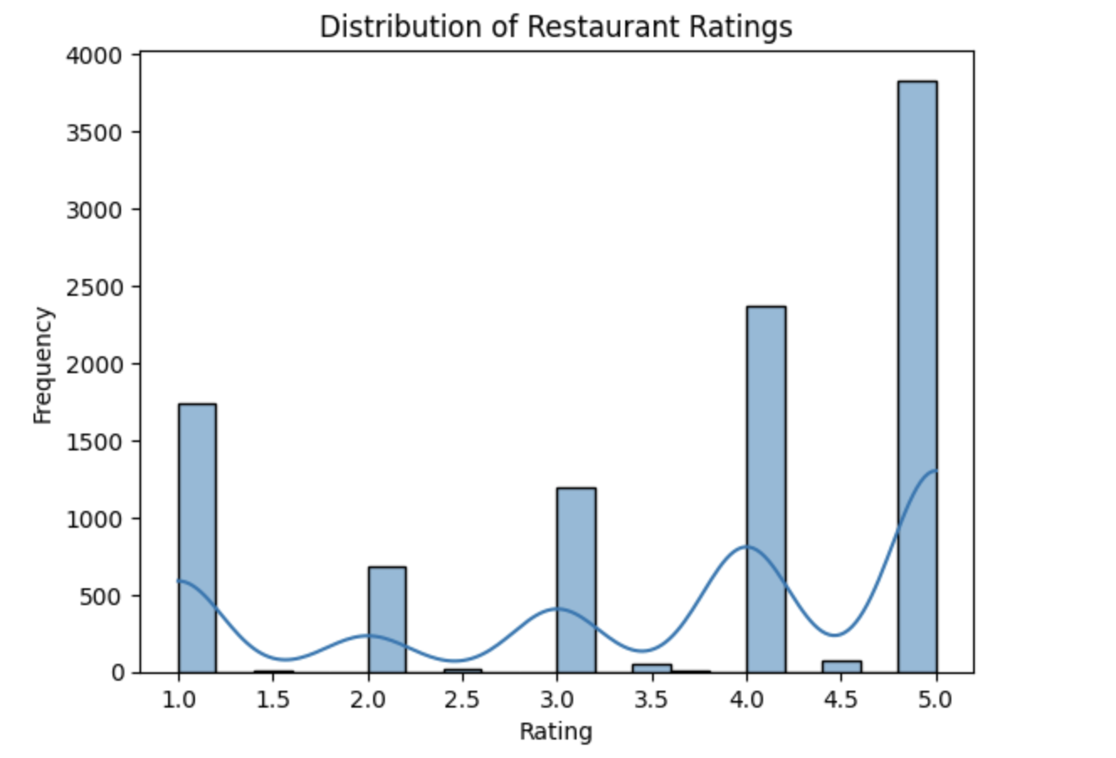
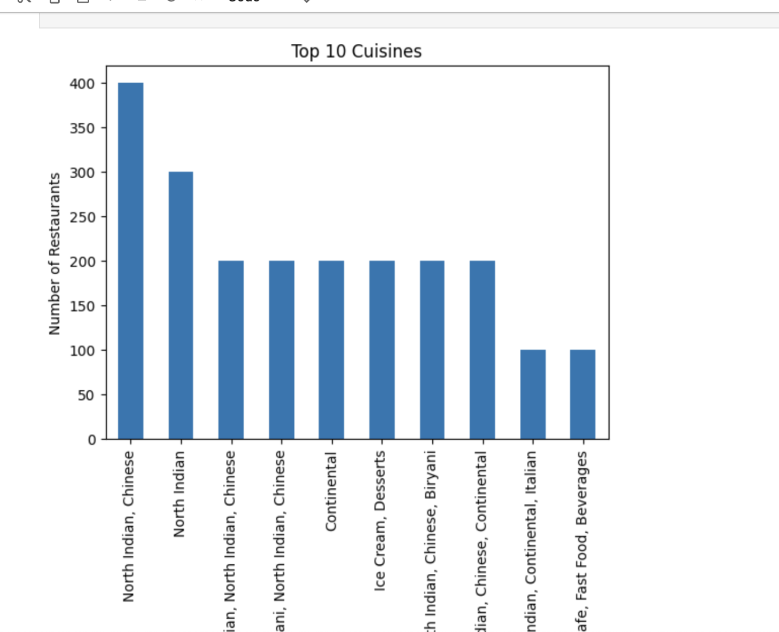
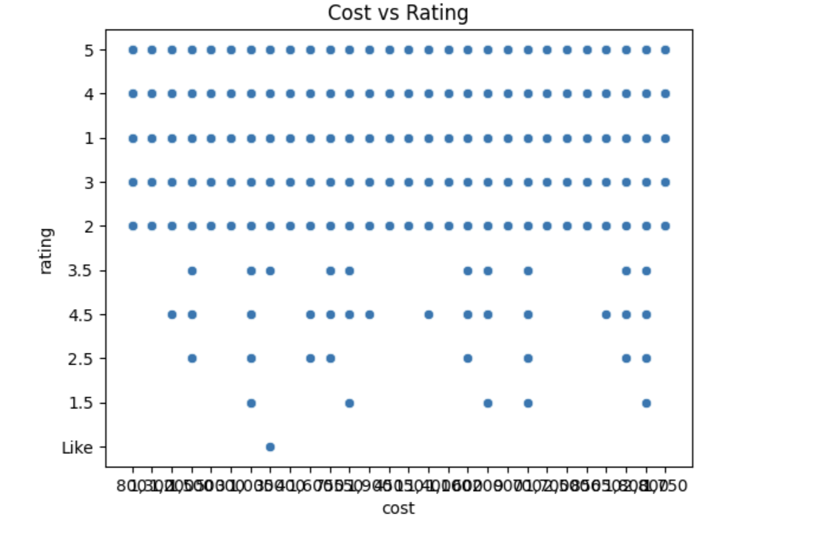
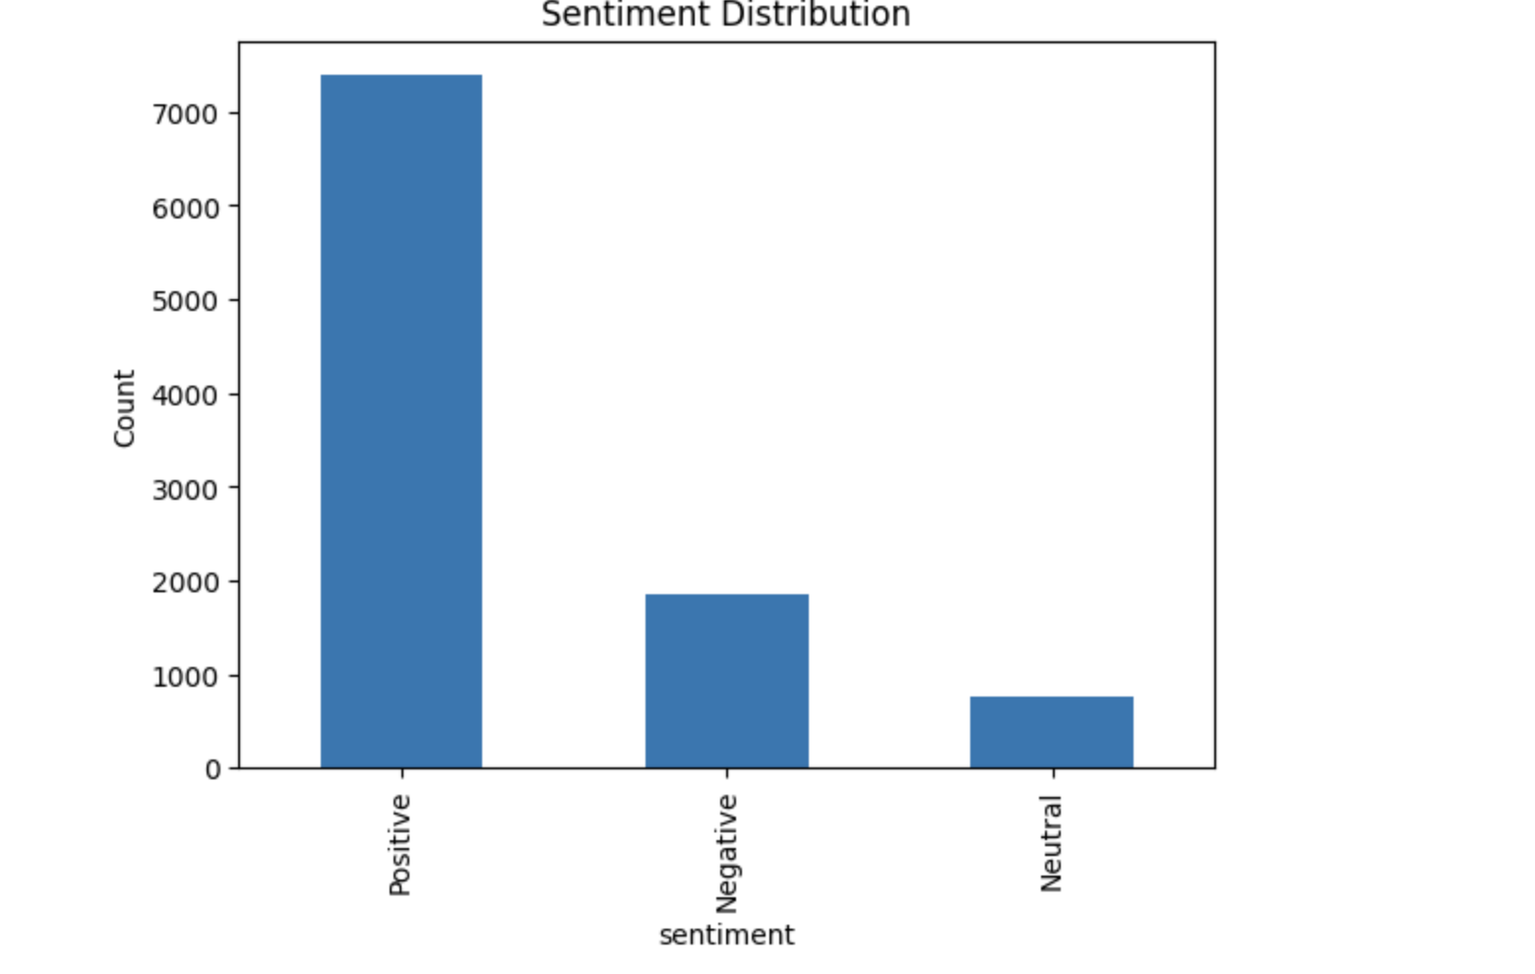
visulization

Slide 9
conclusion
Zomato restaurant data analysis provides valuable insights into customer preferences and behavior
Python helps analyze ratings, cuisines, and customer sentiment effectively
Popular cuisines and higher ratings contribute to better restaurant performance
Sentiment analysis helps identify strengths and areas for improvement
Overall, data-driven decisions help restaurants increase customer satisfaction and business growth

